Slide 1
Deploy React App on AWS S3 using CI/CD
By Mahendra Choudhary

Slide 2
Objectives
Simplify the deployment process for Nodejs applications.
Automate deployment pipeline using GitHub Actions.
Enable scalable hosting of NodeJS apps on AWS EC2.
Deliver exceptional user experiences through reliable deployments.
Empower developers with knowledge and tools for efficient deployment and hosting.

Slide 3
Prerequisites
Basic understanding of React.js.
GitHub account for repository hosting and GitHub Actions.
AWS account for hosting the application.
Access and permissions for GitHub and EC2 instance.
Familiarity with YAML configuration.
Command-line interface (CLI) proficiency.

Slide 4
Creating Repository
Go to account
Create new repository with name(Ex. NodeJS App)
Make sure you select it as Public
Uncheck Readme.md
Now you will have to setup NodeJS App in local machine
After this set origin of this repo to local NodeJS App (Refer next slide …)

Slide 5
Basic NodeJS App project on local machine
Prerequisite:
Nodejs V18, NPM, Git, VScode should be installed on your machine
Local machine should have internet connection.
Create folder NodeJSAPP
Inside folder Run npm init -y
Run command: npm install express
Create file app.js
Write below code in app.js
const express = require("express");
const cors = require("cors");
const app = express();
app.use(cors());
app.use(express.json());
app.use("/", (req, res) => {
res.json({
msg: "Hi, This is the latest express JS app deployed to AWS EC2 using github action by Mahendra Choudhary"
})
})
app.listen(8000, () => console.log(`server is running on port ${8000}`))
Now set up the origin of github repo to this project:
Example:
git remote add origin https://github.com/whoismayank/nodejs-app.git
git branch -M main
git push -u origin main

Slide 6
Create IAM user on AWS
Go to AWS Console
Search EC2
Click on “Launch Instance”
Click on Create user button
Give name to your instance for ex. My MERN app server
In Application and OS Images search Ubuntu and select Ubuntu Server 22.04 LTS (HVM)
Instance type must be t2.micro(which is free)
In Key pair (login) click on “Create key pair” and download pem file(ppk for windows OS). Note: This will help us to access our EC2 instance
Download the .pem file and keep it to downloads folder.
Click on “Launch instance” button
It will take some time to start EC2 instance

Slide 7
Connect EC2 instance
On AWS console go to EC2 -> Instances -> your instance
Click on connect
Click on “SSH client” tab
Copy text which start with SSH
Go to your local folder where pem file is saved
Open that folder in terminal and paste
ssh -i "es2.pem" ubuntu@ec2-18-204-228-200.compute-1.amazonaws.com
After pressing Enter key your EC2 instance will connect using ssh

Slide 8
EC2 instance setup
Once you connected to EC2 instance using SSH
Run below comma:
sudo apt update
curl -fsSL https://deb.nodesource.com/setup_lts.x | sudo -E bash -
sudo apt-get install nodejs
sudo apt-get install nginx
systemctl status nginx
Nginx status should be Active
node -v
Node version should be visible
sudo npm install pm2 -g
PM2 will help us to keep running our nodejs application in background

Slide 9
Setup CI/CD workflow manifest
In your local repo folder
Create folder: .github\workflows
Create manifest file node.js.yml
Paste below content
# This workflow will do a clean installation of node dependencies, cache/restore them, build the source code and run tests across different versions of node
# For more information see: https://help.github.com/actions/language-and-framework-guides/using-nodejs-with-github-actions
name: Node.js CI
on:
push:
branches: [ "main" ]
jobs:
build:
runs-on: self-hosted
strategy:
matrix:
node-version: [20.x]
# See supported Node.js release schedule at https://nodejs.org/en/about/releases/
steps:
- uses: actions/checkout@v3
- name: Use Node.js ${{ matrix.node-version }}
uses: actions/setup-node@v3
with:
node-version: ${{ matrix.node-version }}
cache: 'npm'
- run: npm ci
- run: npm run build --if-present
- run: pm2 stop server || true
- run: pm2 delete server || true
- run: pm2 start server.js

Slide 10
Push changes and configure EC2 to execute CI pipeline
Once you created workflow file push to changes to main branch
You can see your CI/CD pipeline running in Github -> your repo -> Actions
See next slide to setup Runner on EC2

Slide 11
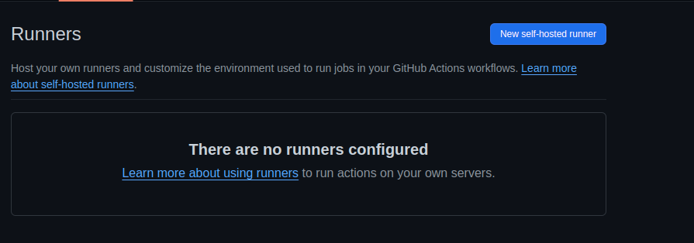
Installation of Runners on Host(EC 2) machine(Part 1)
Go to Setting tab in github repository
You will see Actions tab in sidebar
Click on Actions -> Runners button
You will see page like this ⬇️, Click on “New self-hosted runner” button
Reference: https://docs.github.com/en/actions/hosting-your-own-runners

Slide 12
Installation of Runners on Host(EC 2) machine(Part 2)->(Runner download)
After clicking on “New self-hosted runner” button you will see page to configure runner on system.
Select Runner image as per your system OS(PS. I am selecting Linux.
Select OS Architecture as per your system(I am selecting X64)
On Same page you will see bunch of commands to setup runner on your machine
Open VSCode Terminal
Run command: mkdir actions-runner && cd actions-runner (It will directory to run action runner on your host machine)
Run command: curl -o actions-runner-linux-x64-2.311.0.tar.gz -L https://github.com/actions/runner/releases/download/v2.311.0/actions-runner-linux-x64-2.311.0.tar.gz (It will download tar file to configure runner)
Run command: tar xzf ./actions-runner-linux-x64-2.311.0.tar.gz
Reference: https://docs.github.com/en/actions/hosting-your-own-runners

Slide 13
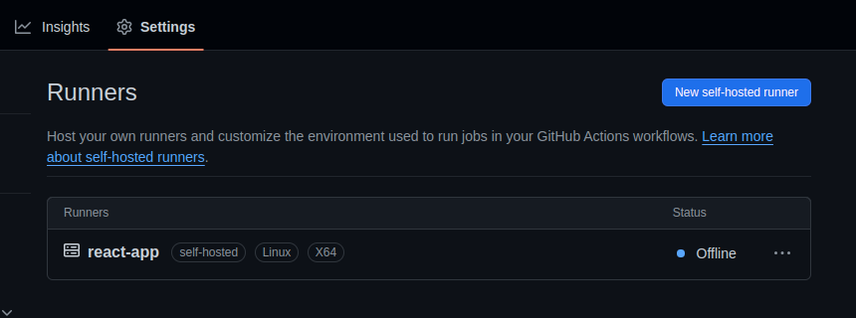
Installation of Runners on Host(EC 2) machine(Part 3)->Runner Connection
On same github page you will see one section with name Configure
You will see command like this: ./config.sh --url https://github.com/whoismayank/test --token ALDNNXZK3dB2MC6HROEHSBMTFWC5GU
You will have to run this command to connect your machine to github CI/CD
After running this command when you go to github runner, you can see your runner in Offline status

Slide 14
Installation of Runners on Host(EC 2) machine(Part 4)->Runner Start
After connecting the runner to github account you have to start it on your local machine:
You can start running it in two ways
Either using ./run.sh (If it doesn't work try running it with Sudo), Note(It will stop running once you close the terminal)
Or you can use:
sudo ./svc.sh
sudo ./svc.sh install
sudo ./svc.sh start
sudo ./svc.sh status
It will start runner as a system service which will keep it running in background.
Now when you will come back to github runner status will changed to Idle or Online
Woila 🎉: Your CI/CD pipeline is done, when you will push your changes to main branch, It will Deploy service to your host machine.

Slide 15
Setup Nginx
We will be going to setup nginx server to run deployed application on host machine.
Open linux terminal
Run command: sudo apt update
Run command: sudo apt install nginx
Check status of Nginx: systemctl status nginx (It should be in active(running) status)
If it is not in running status you can try starting it by using systemctl start nginx
Go to “/etc/nginx/sites-available” folder, Open terminal and write: “code .”
It will open this folder in VS code.
You will see one file named as default
sudo nano default
Update below code above the 404 location code
location /api/ {
proxy_pass http://localhost:8000/;
proxy_set_header Host $host;
proxy_set_header X-Real-IP $remote_addr;
proxy_set_header X-Forwarded-For $proxy_add_x_forwarded_for;
}
Basically when we setup our runner on setup machine it created 1 build of the app inside the /actions-runner folder, We will have to update that path in root.
Example:
Now restart nginx server: systemctl restart nginx
After doing this you can see your application running on: http://localhost/api/
But we have to make accessible the port 80 on EC2 instance on AWS see in next slide

Slide 16
Setup EC2 instance to route traffic
Basically our application is setup on port 8000
But user will access it from port 80 because default port of http protocol is 80
So we have to enable traffic on port 80 on EC2 console (We already routed traffic using nginx on server)
Go to AWS -> EC2 -> Security Groups -> Select security group which you have selected/created during the process of launch of EC2 instance
Click on “Inbound Rules” -> Edit inbound rules button
Select Type=HTTP make sure port is 80
Enter IP: 0.0.0.0/0
Click on “Save rules” button
You have successfully enabled traffic from Internet using http method
Now you can open your instance public IP in browser and it will show basic nginx page

Slide 17
Test your CI/CD
Do some changes on your local code
Push your local changes to main branch
Go to actions tab on github repo
See your workflow build running
Once it successfully created
Copy your instance IP and with endpoint /api
Open browser and hit
You will see your updated changes on browser
You are done with your pipeline

Slide 18
Thank you
If you have any questions, feel free to reach out later.
Mahendra Choudhary
+91-8602687255
Notes:
https://www.youtube.com/watch?v=X3F3El_yvFg&ab_channel=TraversyMedia

